Slide 1
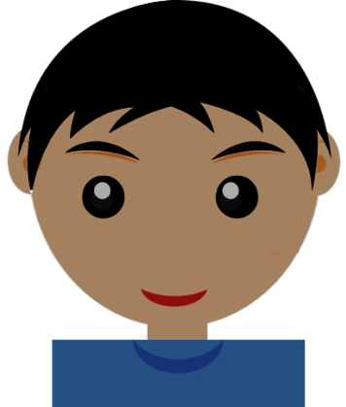
Stay safe
on
Pupil Rules
Log on using only your allocated username and password
Never share your password, even with a friend
Use the Internet only with teacher permission
Download from the Internet only with teacher permission
Do not use message boards or forums unless you have permission to access them and only do so for educational use.
Never search for inappropriate information
Never use instant messaging or social media without permission from your teacher
Do not use social networking sites (e.g. Twitter or Facebook) instead use glow.
Never buy anything from the Internet in school
If asked, show the teacher all emails/messages received or sent
Never use bad language
Never send messages which could cause offence or upset to anyone (known as Cyberbullying)
Never give out personal information
Never send photographs which could identify yourself or individuals
Never arrange a meeting with anyone on the Internet
Report to the teacher anything which makes you feel uncomfortable
Report any misuse of the Internet rules
Always log off when work is completed
the
internet
REMEMBER: ALL INTERNET ACCESS, including email, IS MONITORED
School rules about acceptable behaviour apply when using the Internet.
Your teacher or headteacher may contact your parents if you break these rules.
When accessing the Internet and using email, you must always follow the rules above:
Education and Children’s Services

Slide 2
Stay safe
on
When accessing the Internet and using email, you must always follow the rules below:
the
Internet Pupil Rules
Internet!
Log on using only your allocated username and password
Never share your password, even with a friend
Use the Internet only with teacher permission
Download from the Internet only with teacher permission
Do not use message boards or forums unless you have permission to access them and only do so for educational use.
Never search for inappropriate information
Never use instant messaging or social media without permission from your teacher
Do not use social networking sites (e.g. Twitter or Facebook) instead use glow.
Never buy anything from the Internet in school
If asked, show the teacher all emails/messages received or sent
Never use bad language
Never send messages which could cause offence or upset to anyone (known as Cyberbullying)
Never give out personal information
Never send photographs which could identify yourself or individuals
Never arrange a meeting with anyone on the Internet
Report to the teacher anything which makes you feel uncomfortable
Report any misuse of the Internet rules
Always log off when work is completed
REMEMBER
ALL INTERNET ACCESS, including email, IS MONITORED
School rules about acceptable behaviour apply when using the Internet.
Your teacher or headteacher may contact your parents if you break these rules.

Slide 3
Stay safe
on
When accessing the Internet and using email, you must always follow the rules below:
the
Internet Pupil Rules
Internet!
Log on using only your allocated username and password
Never share your password, even with a friend
Use the Internet only with teacher permission
Download from the Internet only with teacher permission
Do not use message boards or forums unless you have permission to access them and only do so for educational use.
Never search for inappropriate information
Never use instant messaging or social media without permission from your teacher
Do not use social networking sites (e.g. Twitter or Facebook) instead use glow.
Never buy anything from the Internet in school
If asked, show the teacher all emails/messages received or sent
Never use bad language
Never send messages which could cause offence or upset to anyone (known as Cyberbullying)
Never give out personal information
Never send photographs which could identify yourself or individuals
Never arrange a meeting with anyone on the Internet
Report to the teacher anything which makes you feel uncomfortable
Report any misuse of the Internet rules
Always log off when work is completed
REMEMBER
ALL INTERNET ACCESS, including email, IS MONITORED
School rules about acceptable behaviour apply when using the Internet.
Your teacher or headteacher may contact your parents if you break these rules.

